Slide 1


AADHAR HACKATHON 2021
PROBLEM STATEMENT-1
ADDRESS UPDATE CHALLENGE IN URBAN AREAS

Slide 2
TEAM MEMBERS :
RENUKA ANANTAPALLI (TEAM LEADER)
PARIKI VISHAL
SANATH MADASU
CHAITRA KATIKANENI
SAKSHITH REDDY CHANDUPATLA

Slide 3
MENTOR :
Mr.T.Mahesh Kumar
Assistant Professor
Department of IT
Kakatiya Institute of Technology and Science , Warangal

Slide 4
EXISTING SYSTEM
When a person migrates to a new location , it is always a problem to update his address .During the initial days of the stay , a person will not be having any address proof in order to update his address .
With this proposed method , the migrant can easily update his/her address with the help of a local landlord . When the request for consent is accepted by the landlord , the migrant can update his address online .

Slide 5
PROPOSED SYSTEM
STEP 1 : LOGIN PAGE.
As soon as a migrant opens the web application , he/she will first encounter different menus namely; home , enrollment menu and login menu .
Any person who does not posses aadhar card , can enroll (for aadhar card) in the “enrollment menu”.
Any aadhar card holder can login to the portal using his/her aadhar number as “username” and the mobile number(linked to their respective aadhar card) as “password” in the “ login menu”.

Slide 6
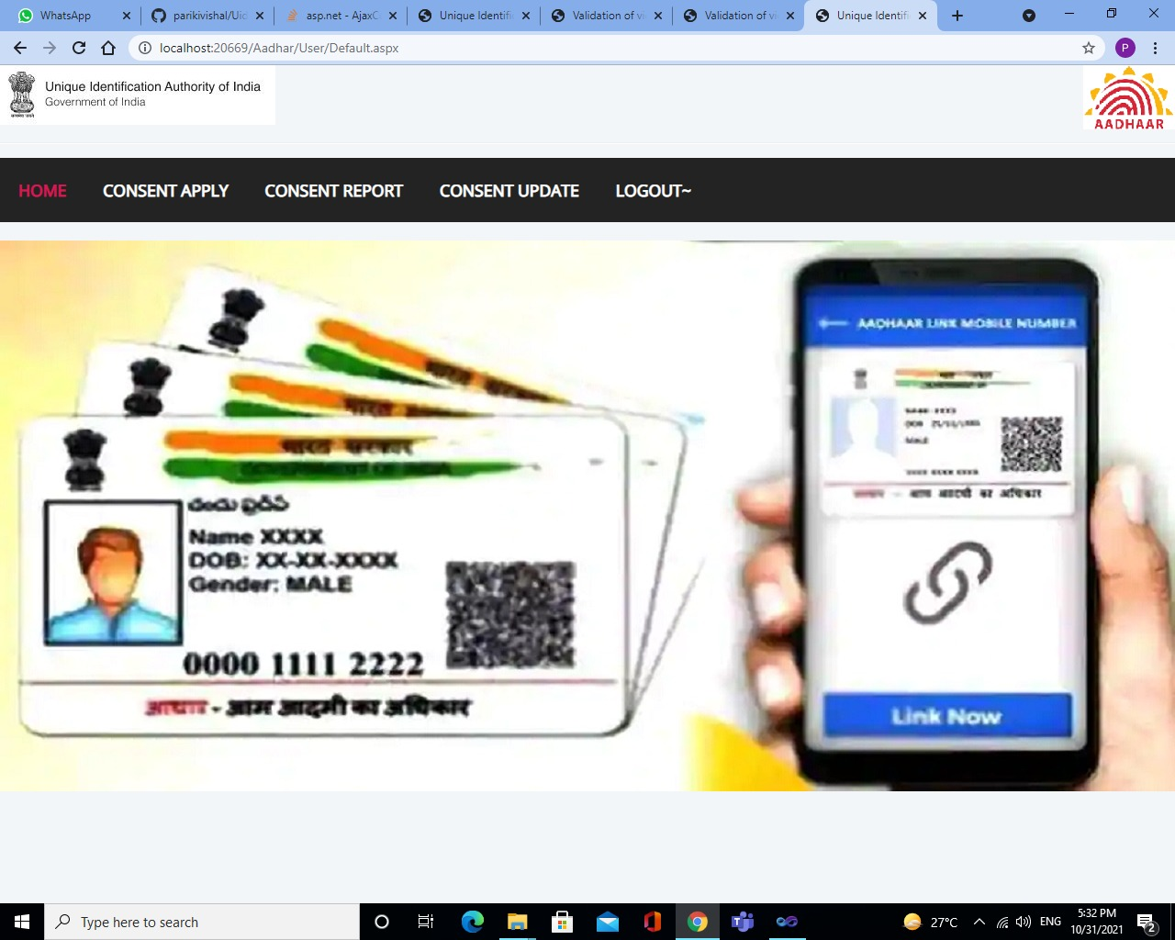

Slide 7
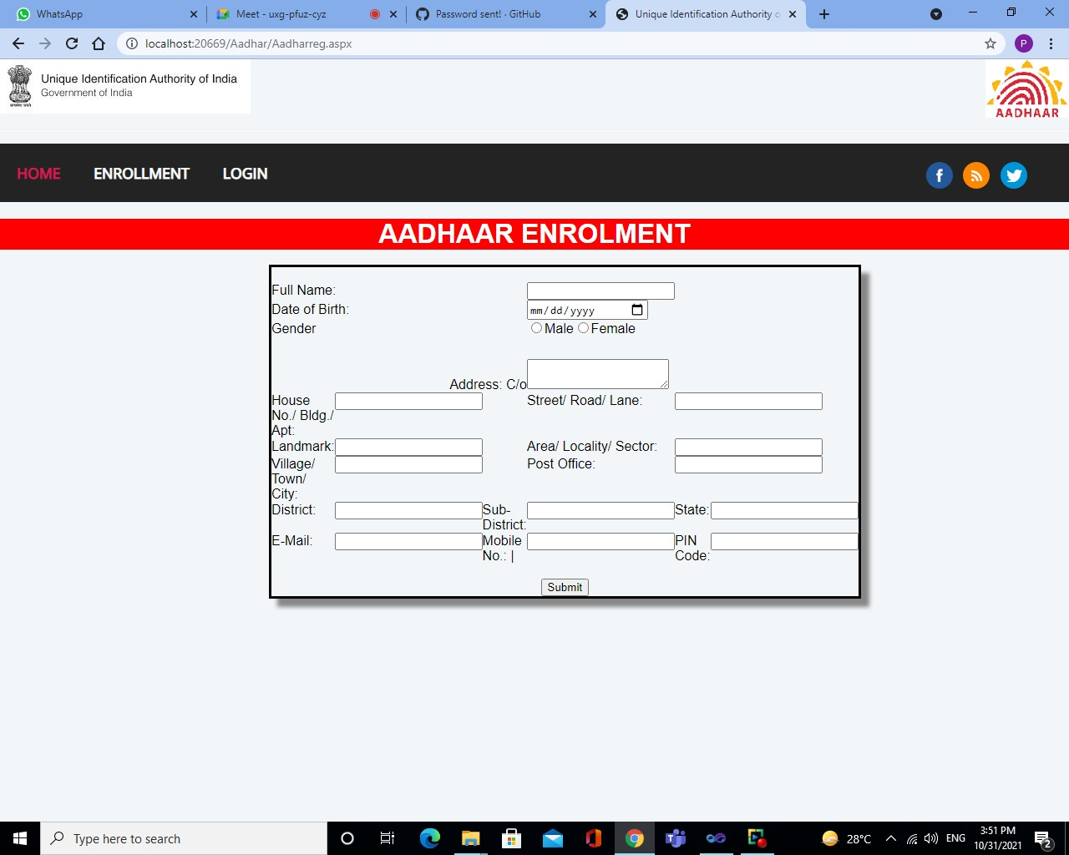

Slide 8
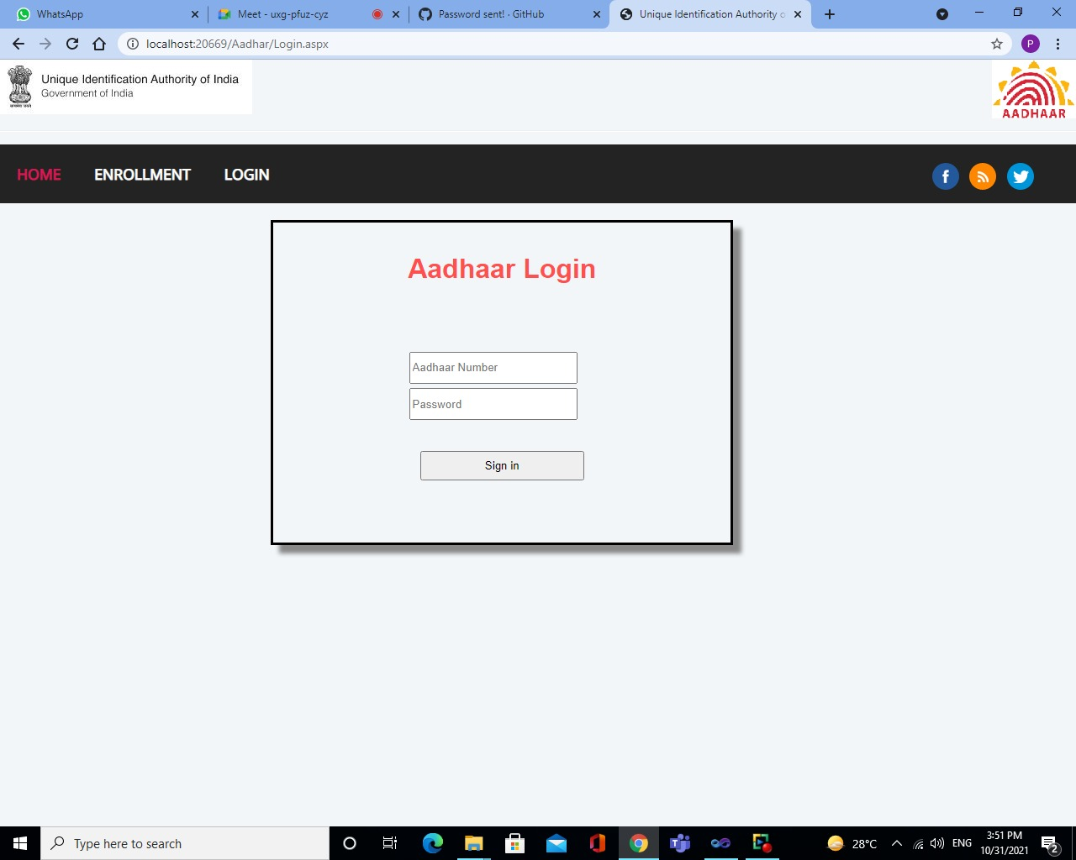

Slide 9
PROPOSED SYSTEM
STEP 2 : GET THE EMAIL ID OF LANDLORD.
A migrant then visits a nearby landlord and ask for his email address . A link will be shared to the landlord’s mail ID which indicates that the request has been sent.

Slide 11
PROPOSED SYSTEM
STEP 3 : THE REQUEST FOR CONSENT TO AADHAR UPDATE IS OBTAINED FROM THE LANDLORD TO THE PERSON REQUESTING FOR UPDATE .

Slide 12
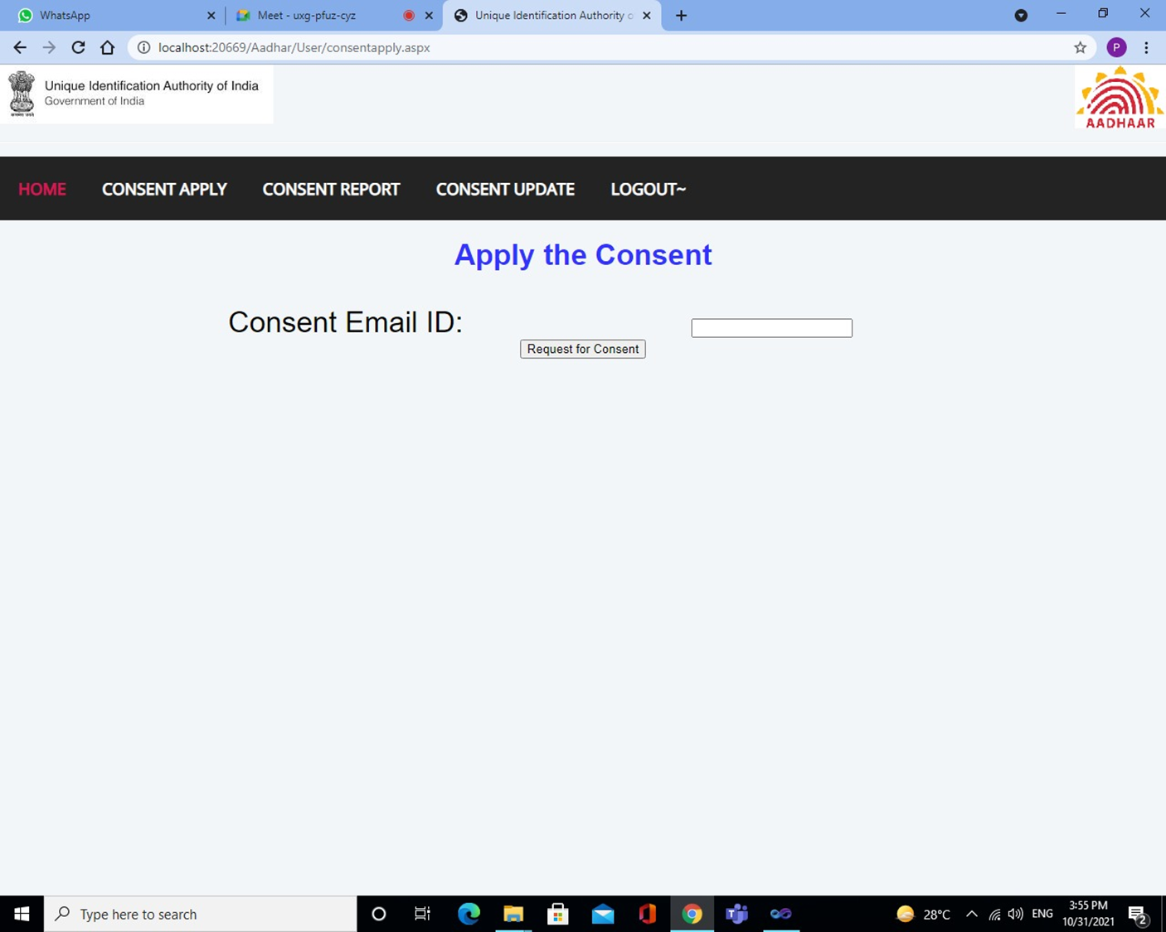

Slide 13
PROPOSED SYSTEM
STEP 4 : LANDLORD HAS TO LOGIN TO THE PORTAL AND ACCEPT THE REQUEST .
After landlord receiving the conformation Email , he should login to the portal and accept to the request sent by the migrant .

Slide 14
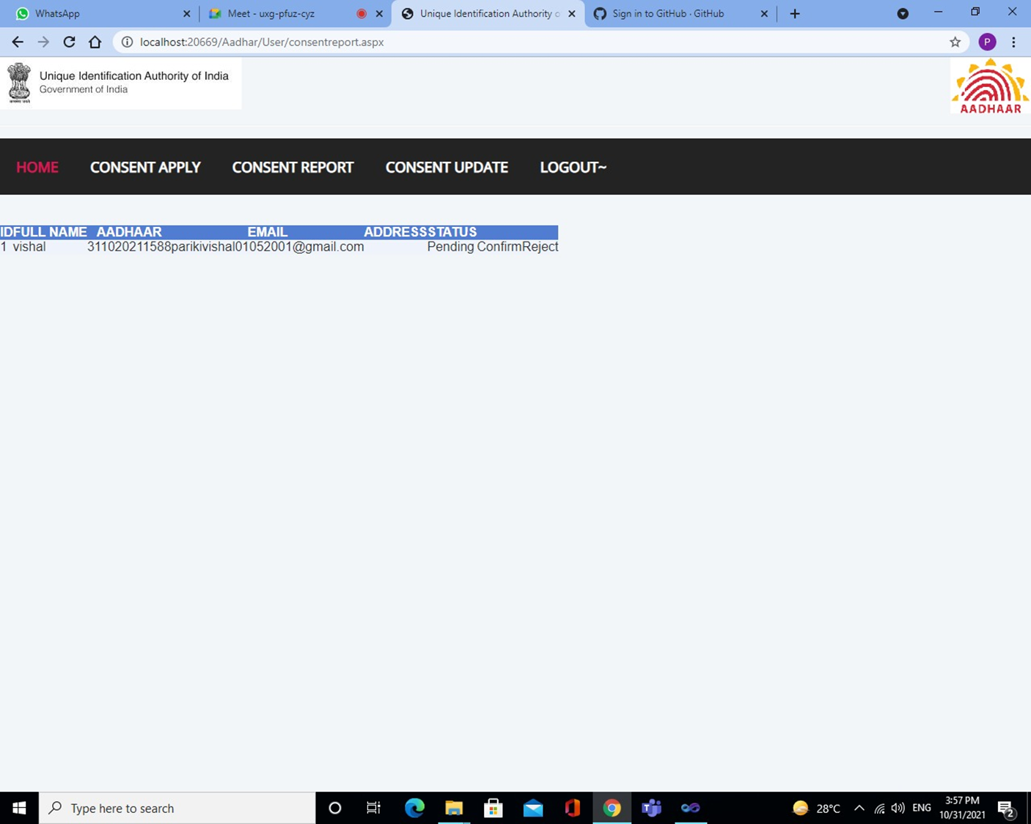

Slide 15
PROPOSED SYSTEM
STEP 5 : AFTER SUCCESSFUL CONFORMATION, ADDRESS OF THE LANLORD WILL BE DISPLAYED (IN THE TEXT BOX OF MIGRANT) .
Once the landlord accepts to the request in the portal (with his login details) , the migrant could access landlord’s address information in the “consent update section” . The migrant can then make minor updates to the address before he/she hits “update” button.

Slide 16
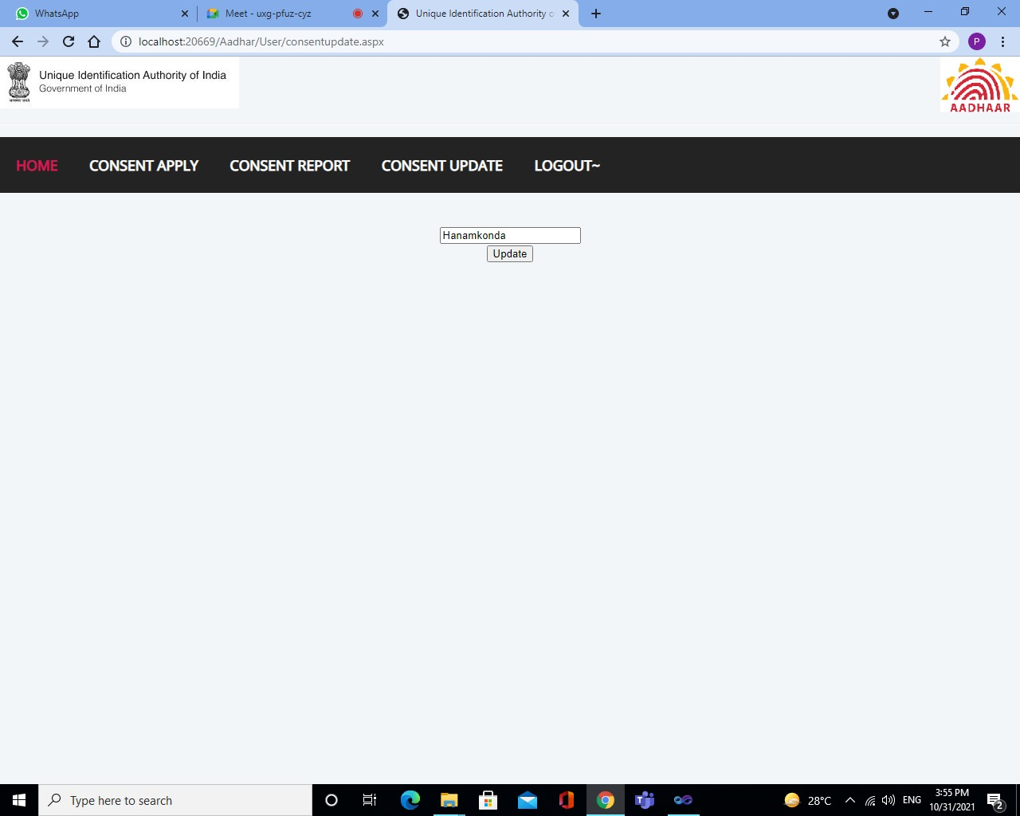

Slide 17
PROPOSED SYSTEM
STEP 6 : ON SUCCESSFUL SUBMISSION , THE DETAILS WILL BE UPDATED IN THE DATABASE.
Once the submit button is clicked , the address of the migrant will be successfully updated .

Slide 18
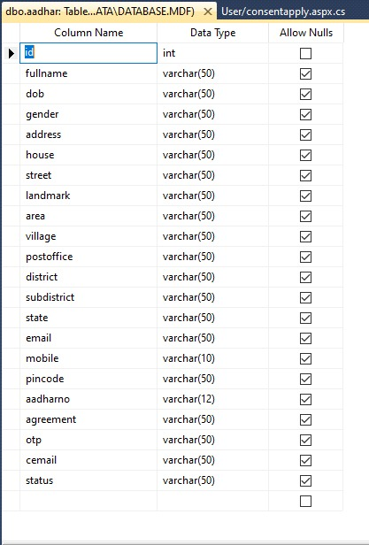
TABLE

Slide 19
THANK YOU..!

